Slide 1
Object Oriented
Design
Tony Baines
March 2013

Slide 2
Introduction
We won’t be talking about
Methodology
Process
… we will be exploring
A vocabulary for talking about design
Some principles for spotting good (and bad) design
Notes:
Methodologies tend to come with salesmen and expensive tools
I recommend lightweight, iterative processes which use implementation as feedback for design

Slide 3
What do you think of when you think of OO?
Inheritance
Data and Methods
Encapsulation
Polymorphism
Coupling
Cohesion

Slide 4
Context
We build systems to solve a problem
We write (design) software to talk to other people
The CPU doesn't care about style
Good code has to both work and communicate with people
Object Orientation is a mindset for humans
Good OO design reflects the understanding of the team

Slide 5
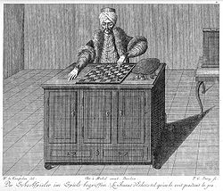
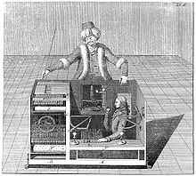
Foundation Concepts
Encapsulation
State and Operations together
Messages go in
Messages come out
How does it work?
Notes:
A fake chess-playing machine constructed in the late 18th century by Wolfgang von Kempelen to impress the Empress of Austria, the mechanism appeared to be able to play a strong game of chess against a human opponent

Slide 6
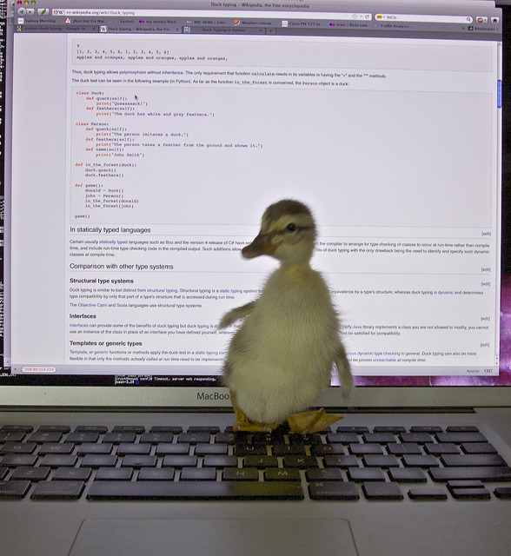
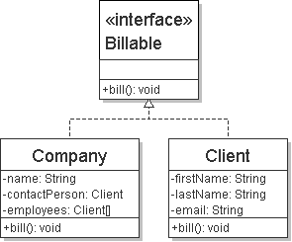
Foundation Concepts
Polymorphism
'Many Shaped'?
One shape on the outside
Different innards

Slide 7
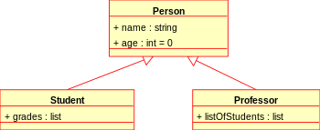
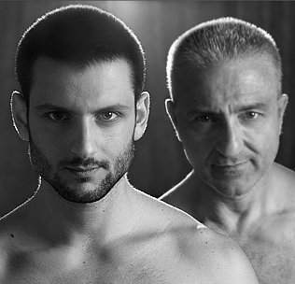
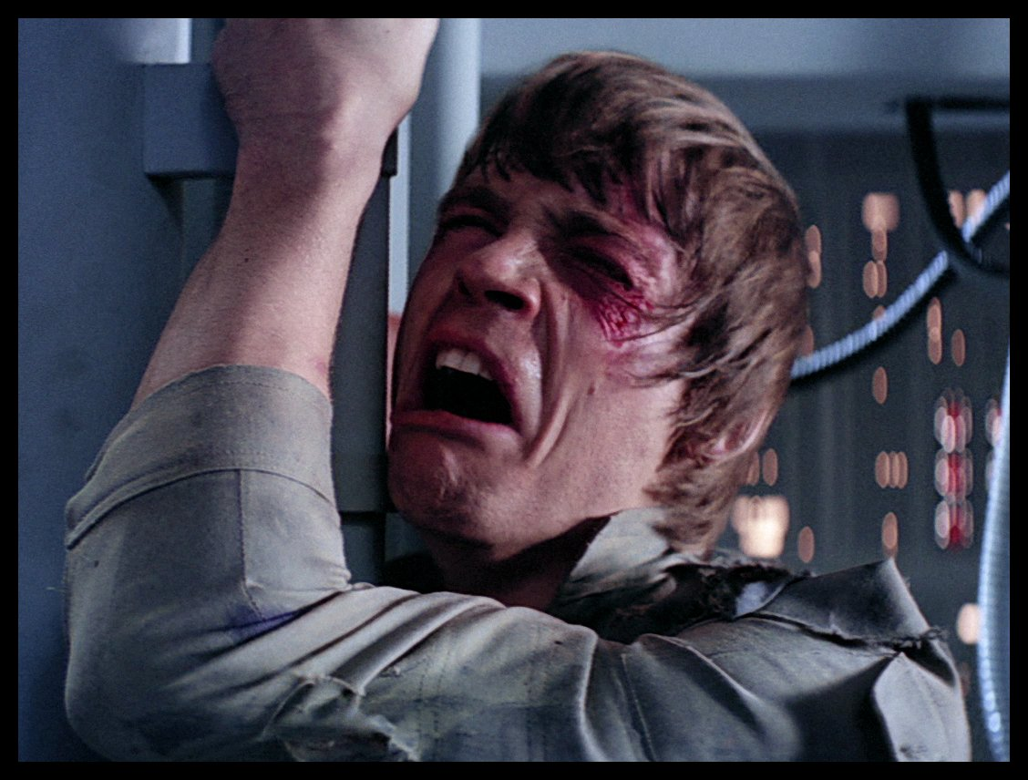
Foundation Concepts
Inheritance
“Is-A” relationship
A cat is a mammal
Subtype-Polymorphism
aka Sub-classing
Reuse definitions

Slide 8
Some UML: Inheritance
Some Class
+attribute: Type
Some Interface
+operation(): Type
+operation(param): Type
Child Class
Implementing Class

Slide 9
Exercise 1: Inheritance
Put the following mammals into a class hierarchy
Bears, Dolphins, Orcas, Gorillas, Humans, Monkeys, Lions
Orders of mammals include Cetacea, Carnivora and Primates
What attributes might they have?
[5 minutes]

Slide 10
Animals
+height
+weight
+lifespan
Mammals
Eutheria
Cetacea
Carnivora
Primates
Dolphins
Orcas
Lions
Bears
Apes
Monkeys
Humans
Gorillas

Slide 11
Exercise 1: Discussion
A common problem/solution
Extensible
Is hierarchy and inheritance equivalent?
Should we add new properties as we go down the tree?
E.g. Number of Arms ?

Slide 12
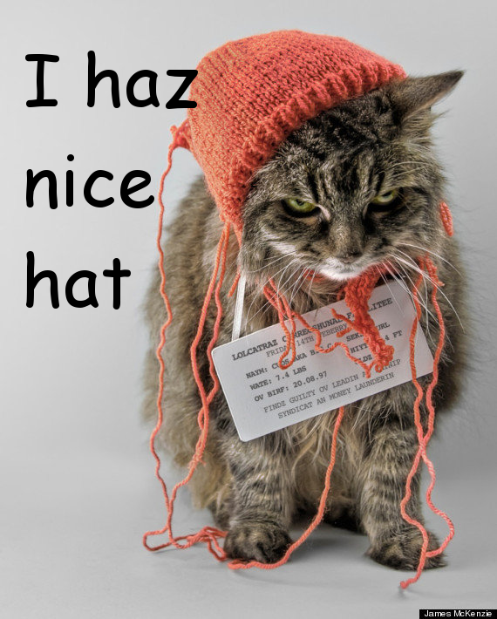
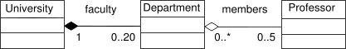
Foundation Concepts
Composition
“Has-A” relationship
A cat has a tail
May or may not share a lifecycle

Slide 13
Some UML: Composition
Some Class
Aggregation
Separate lifecycle
Composition
Shared lifecycle
1
0..*
2
Collaborator
Component

Slide 14
Exercise 2: Composition
Build a car
Chassis
Body
Wheels
Engine
Add driver + passengers
[5 minutes]

Slide 15
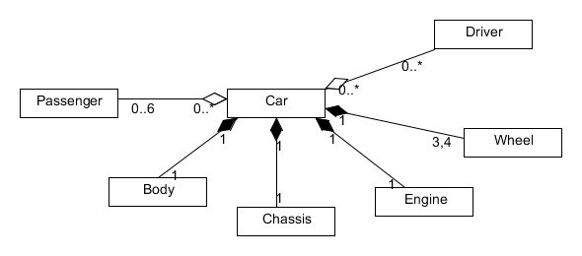

Slide 16
Exercise 2: Discussion
Relationships between different sorts of objects
Specifics can change over time
New wheels
Reuse is still possible
Compose a collaborator with reusable behaviour

Slide 17
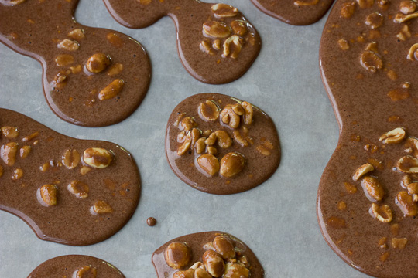
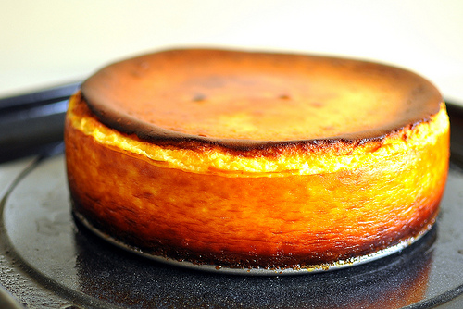
Foundation Concepts
Cohesion
Do one job
One reason to change
One concept encapsulated

Slide 18
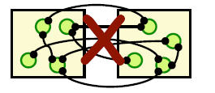
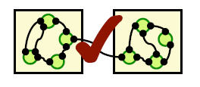
Foundation Concepts
Coupling
What do you need to get things done?
What needs you to get things done?
Trade-off with cohesion
Zero coupling = big ball of mud
Aim to stay Loose

Slide 19
Exercise 3: Back at the Zoo
Back with the animals
Lions, Gorillas, Humans, Dolphins
Add move() operations
How can these be reused?
Do some animals have more than one way to move?
[10 minutes]

Slide 20
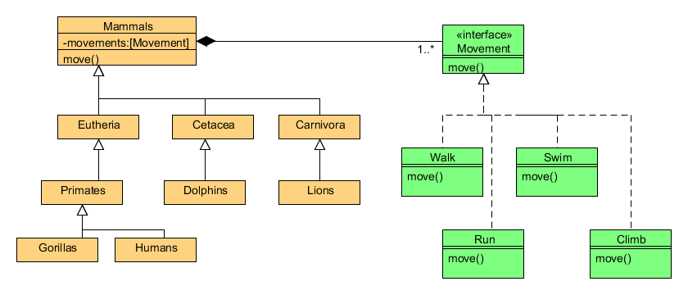

Slide 21
Exercise 3: Discussion
Combining inheritance and composition
Powerful
Captures reusable logic
Flexible
Allows changes during the lifetime of an object

Slide 22
Principles
The simplest thing
that works
YAGNI
You
Aren't
Going to
Need
It
For real applications this only works if;
You refactor
You have tests
Unnecessary complexity is the enemy

Slide 23
A note on Complexity
“Designing software is an exercise in managing complexity”
Jim Reeve - C++ Journal (1992)
Necessary Complexity
Solving hard problems
Accidental Complexity
Gold plating, poor design, premature optimisation, …
Complexity is a cart full of stones, slowing us down

Slide 24
Principles
Don't Repeat Yourself
Every copy-and-paste is another stone in the cart
Two places to fix bugs
Two places to make a change
Two things to understand

Slide 25
Principles
The Principle Of Least Surprise
What would you expect from an API?
What would you hope for in the implementation?
When in doubt
Do the right thing.

Slide 26
S.O.L.I.D
Michael Feathers’ acronym
Robert C Martin’s principles
Uncle Bob

Slide 27
Principles
Single Responsibility
O
L
I
D
Do one thing
High Cohesion
DRY
A place for everything, and everything in it's place

Slide 28
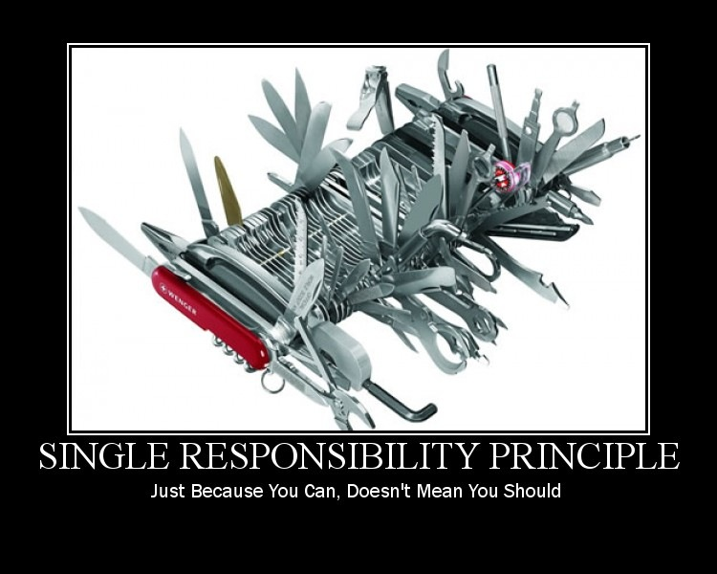

Slide 29
Principles
S
Open Closed
L
I
D
Open for Extension
Subclassing
Interface implementation
Closed for modification
Only changes if it's requirements change

Slide 30
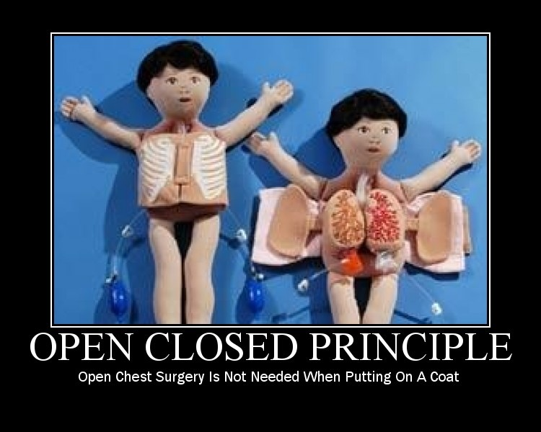

Slide 31
Principles
S
O
Liskov Substitution
I
D
"New classes should be logical, consistent extensions of their super-classes"
Barbera Liskov (1987)
The client of an API shouldn't need to know about different implementations
Principle of Least Surprise

Slide 32
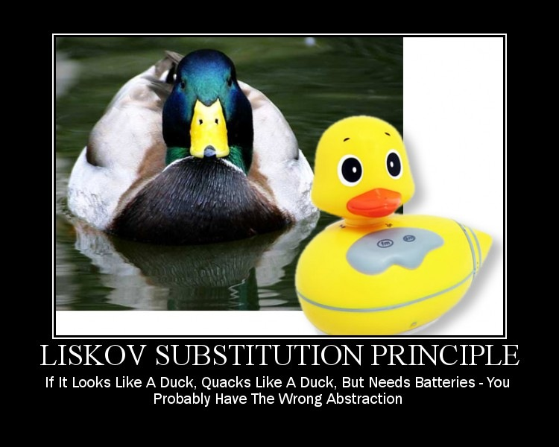

Slide 33
Principles
S
O
L
Interface Segregation
D
It's better to depend on a small interface than a large one
It's better to implement a small interface than a large one
Break large interfaces down into smaller ones

Slide 34
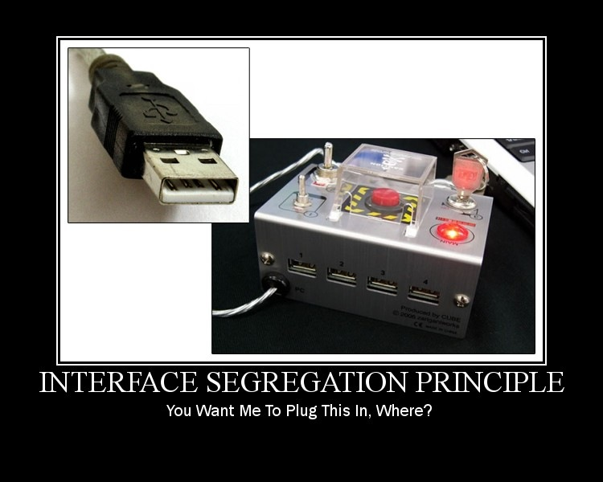

Slide 35
Principles
S
O
L
I
Dependency Inversion
High-level modules should not depend on low-level modules. Both should depend on abstractions.
Abstractions should not depend upon details. Details should depend upon abstractions.
BDD helps here
Dependency Injection helps too

Slide 36
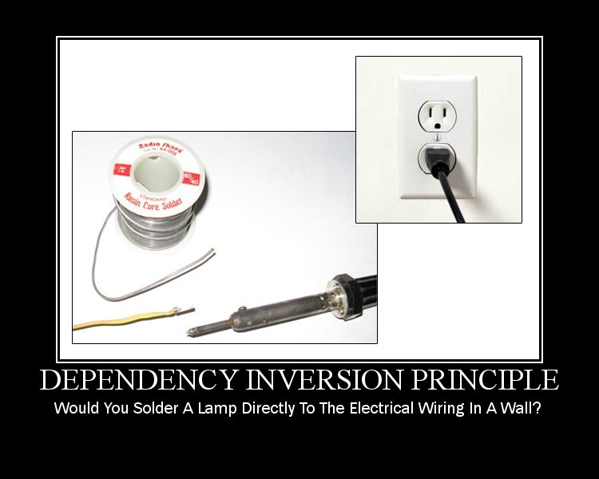

Slide 37
Principles
Law Of Demeter
Formally, the Law of Demeter for functions requires that a method m of an object O may only invoke the methods of the following kinds of objects:
O itself
m's parameters
Any objects created/instantiated within m
O's direct component objects
A global variable, accessible by O, in the scope of m
Notes:
Named for the Demter Project

Slide 38
Principles
Law Of Demeter
Principle of Least Knowledge
It's all about encapsulation, coupling & cohesion
An object should avoid invoking methods of a member object returned by another method.
Use one dot

Slide 39
Practices
CRC Cards
Classes, Roles, Collaborators
A tool for discussion
Class
Role
What I do
Single Responsibility Principle
Cohesion
Collaborators
Who I collaborate with
Coupling
Dependency Inversion Principle

Slide 40
Practices
UML
An industry standard
But useful anyway
A tool for communication
Delivers no features
Can be generated from code
Short lifetime otherwise
Divergence from reality
Whiteboard it + photo
Implies low-ceremony

Slide 41
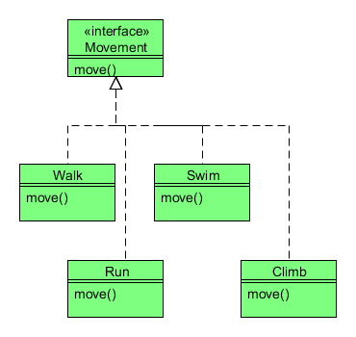
Practices: UML
Class Diagram
Static relationships
Hierarchies
Can be generated from code by tools

Slide 42
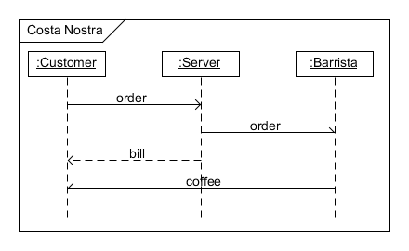
Practices: UML
Sequence Diagram
Dynamic interactions
Useful communication tool
Really useful conversation tool

Slide 43
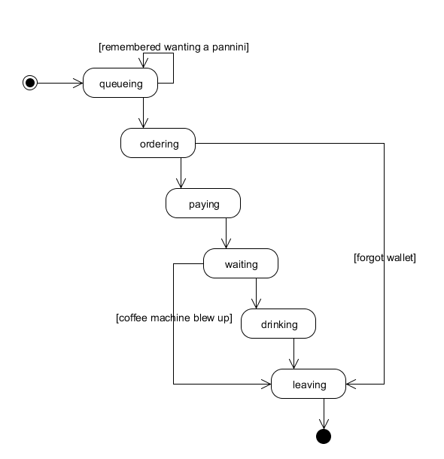
Practices: UML
State Diagram
Dynamic behaviour
Fits well with State pattern

Slide 44
Exercise 4: Cash Machine
Design a system for an ATM / Cash Machine
Authentication (PIN)
Check balance
Withdraw money
Up to current balance
Less than £200
Audit all activity
Assume
An infinite supply of £10 notes
Existing authentication and auditing services
[20 minutes ]
Notes:
Mixed-experience groups
Collaborative
Share some design artefacts

Slide 45
Exercise 4: Discussion
What do you like about your design?
Did you have to break any of the principles?
How did you come up with it as a group?
Which tools were useful?

Slide 46
Practices
Micro types
Capture the concept of domain types
Strongly-typed
e.g. Order ID
update(String orderId, String reasonCode)
update(OrderID id, Reason reason)
Collections
public class Orders extends List<Order>{...}

Slide 47
Practices
Design Patterns
Solutions for common problems
Encapsulate variations
A common language / shorthand
BUT
They're not where you start, they're where you finish
Refactor to patterns
in response to code-smells

Slide 48
Practices: Design Patterns
Creational
Factories
Encapsulate the knowledge of how to build different variations of a type
Builders
Encapsulate how to assemble families of related objects
Singleton
Manage the lifecycle of expensive or scarce resources
Doesn't need to be global shared state
Notes:
This is basically what Spring and other Dependency Injection containers look after

Slide 49
Practices: Design Patterns
Structural
Adaptor
Translate between different protocols (encapsulate the differences)
Facade
Hide a complex API behind a simpler one
Decorator
Wrap one object in another of the same type and add behaviour
Java IO libraries
Composite
Homogeneous tree structures e.g. Files/Directories

Slide 50
Practices: Design Patterns
Behavioural
State
Encapsulate differences in behaviour into objects
Common refactoring for big conditional blocks
Runtime re-composition
Strategy
Encapsulate different algorithms
Composition
Iterator
Encapsulate how to traverse a structure
Built in to most languages

Slide 51
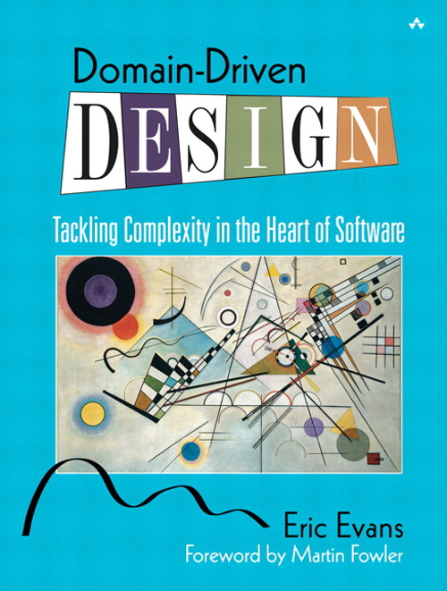
Practices
Domain Driven Design (Eric Evans)
Entities
Concepts from the problem domain
Data and behaviour
Services
Logic which doesn't belong to an entity
Value Objects
Immutable containers for data

Slide 52
Exercise 5: Group Therapy
What is the worst / most-interesting violation of OO principles you’ve come across?
Phrase in terms of coupling/cohesion/SOLID etc.
What did / would you do to fix it?
Why is that better?
[5 minutes]

Slide 53
Closing Thoughts
It will never be perfect
The key to good design is knowing when to stop
Protect yourself with Tests
Accept change
Principles apply at different scales
As below, so above
Intra-module
Inter-module/Intra-system
Inter-System
B2B

Slide 54
Closing Thoughts
Do the right thing
YAGNI (least complexity)
Make it Work
Make it Right
Make it Fast
DRY
Single Responsibility Principle
Seek feedback
Keep Learning

Slide 55
The Golden Rule
“Always code as if the person who ends up maintaining your code is a violent psychopath who knows where you live.”
Ward Cunningham

Slide 56
Retrospective
Post-its on the table
What you liked
What you missed
What was confusing

Slide 57
Spare Slides

Slide 58
Principles
Zero
One
Many
Will there always just be one of these?
Yes: design for one
No: design for many

